Slide 1

Logistic Regression
Presentation by: Dr. Ashima Tyagi

Slide 2
Outline
Classification
Logistic regression
Numerical
Loss Function

Slide 3
CLASSIFICATION
Classification is a machine learning task that involves categorizing input data into classes or categories based on their features.
Classification problems are an important category of problems in analytics in which the outcome variable or response variable (Y) takes discrete values.

Slide 4
Some common types of classification algorithms include:
Binary Classification: This is the simplest form of classification, where the goal is to classify instances into one of two classes. Examples include spam detection (spam or not spam) and medical diagnosis (disease or no disease).
Multi-class Classification: In multi-class classification, instances are classified into one of more than two classes. Examples include image classification (cat, dog, bird, etc.) and hand-written digit recognition (0-9).

Slide 5
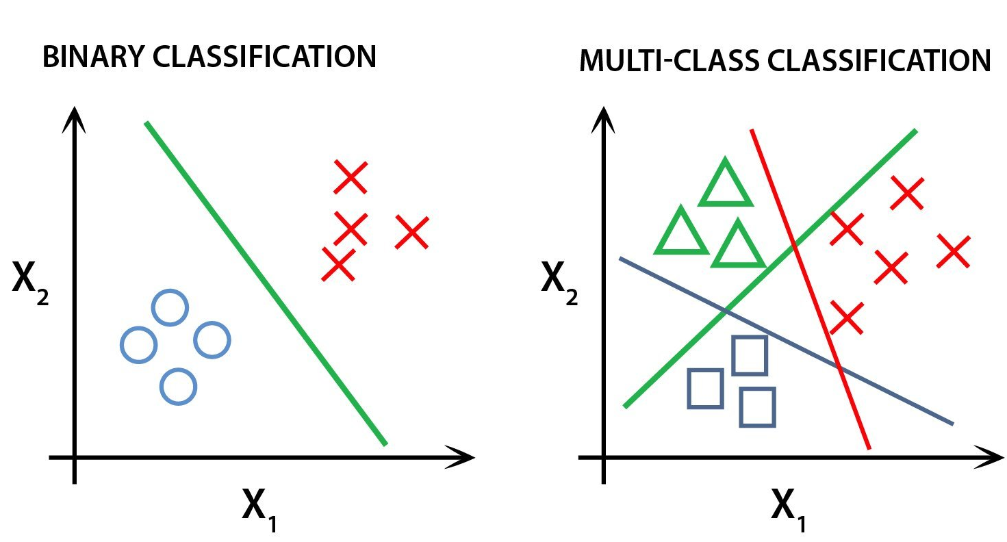
Classification
Two classes: Cross and circle
Three classes: Cross, triangle and circle

Slide 6
Logistic Regression
Logistic regression is a classification algorithm, not a regression algorithm, despite its name.
It’s referred to as regression because it is the extension of linear regression but is mainly used for classification problems.
Logical regression analyzes the relationship between one or more independent variables and classifies data into discrete classes.
It is used to predict the probability that a given input example belongs to a particular class.
The class can be anything such as True or False, Cat or Dog, Apple or Strawberry.

Slide 7
Binary Logistic Regression Model
Logistic regression
If the outcome variable takes only two values, then the model is called binary logistic regression model.
It can identify: Determine the probability of heart attacks

Slide 8
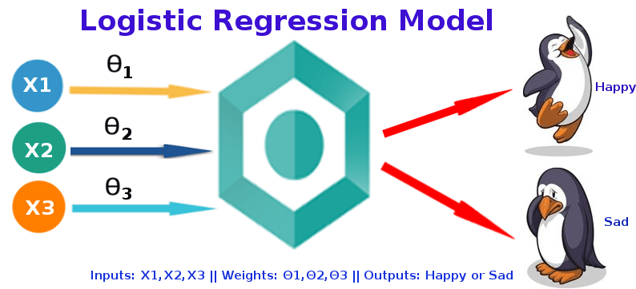
Logistic regression

Slide 9
Working of Logistic Regression Model
Logistic regression
It takes input as independent variables and produces a probability value between 0 and 1.
It uses a function : Sigmoid function to identify classes.

Slide 10
Sigmoid Function
Logistic regression
Logistic regression uses a logistic function called a sigmoid function to map predictions and their probabilities.
The sigmoid function refers to an S-shaped curve that converts any real value to a range between 0 and 1.

Slide 11

Logistic regression
The sigmoid function is referred to as an activation function for logistic regression and is defined as:
where,
f(x) = sigmoid function
e = base of natural logarithms
X = input to the function.

Slide 12

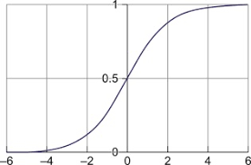
Logistic regression
So a value fed to the function will always return a value between 0 and 1, no matter how big or small the deal is provided.
Graphically, the sigmoid function looks like this,
Threshold value= 0.5
For example, we have two classes Class 0 and Class 1 if the value of the logistic function for an input is greater than 0.5 (threshold value) then it belongs to Class 1 otherwise it belongs to Class 0.

Slide 13
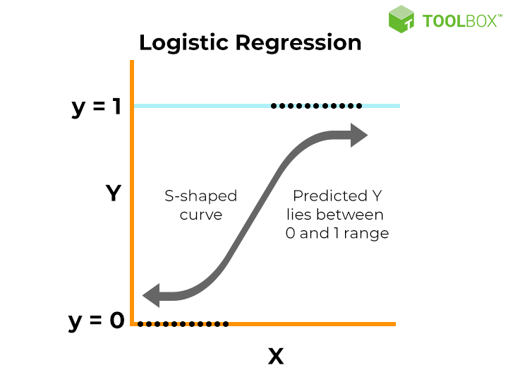
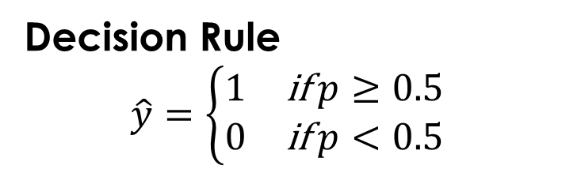
Logistic regression
Decision Rule
$$\hat{y}=\left\{\begin{matrix}1 & \text{if} p≥0.5 \\ 0 & \text{if} p<0.5\end{matrix}\right.$$

Slide 14
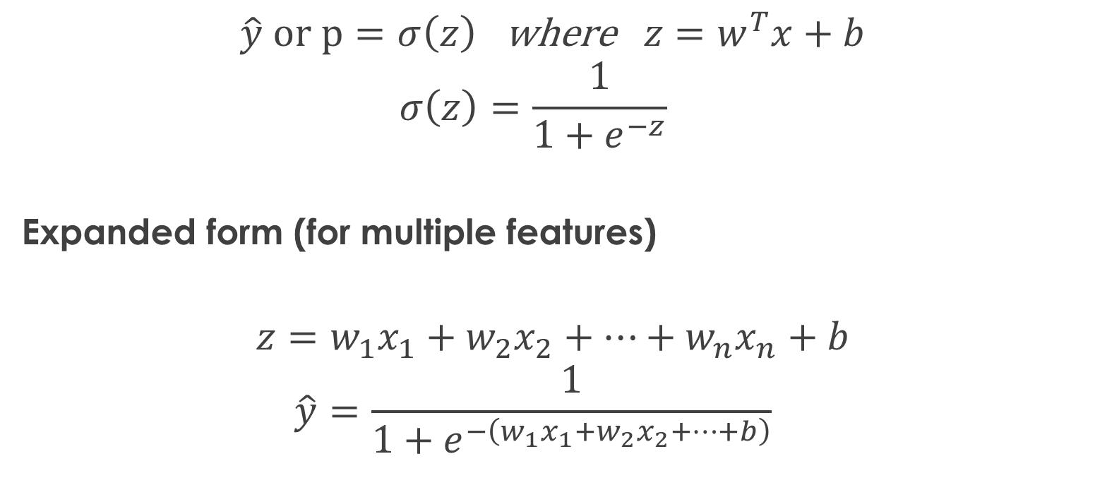
Equation of logistic regression
Logistic regression
Linear regression: y = b0 + b1x1
$$\hat{y} or p=σ\left(z\right) \text{where} z=w^{T}x+b$$
$$σ\left(z\right)=\frac{1}{1+e^{−z}}$$
Expanded form (for multiple features)
$$z=w_{1}x_{1}+w_{2}x_{2}+⋯+w_{n}x_{n}+b$$
$$\hat{y}=\frac{1}{1+e^{−\left(w_{1}x_{1}+w_{2}x_{2}+⋯+b\right)}}$$

Slide 15

Logistic regression
$y$= actual (true) label
Either 0 or 1
$p$= predicted probability
Output of sigmoid
Value between 0 and 1
Interpreted as: $p=P\left(y=1∣x\right)$

Slide 16
Logistic regression
This equation is similar to linear regression, where the input values are combined linearly to predict an output value using weights or coefficient values.
However, unlike linear regression, the output value modeled here is a binary value (0 or 1) rather than a numeric value.

Slide 17
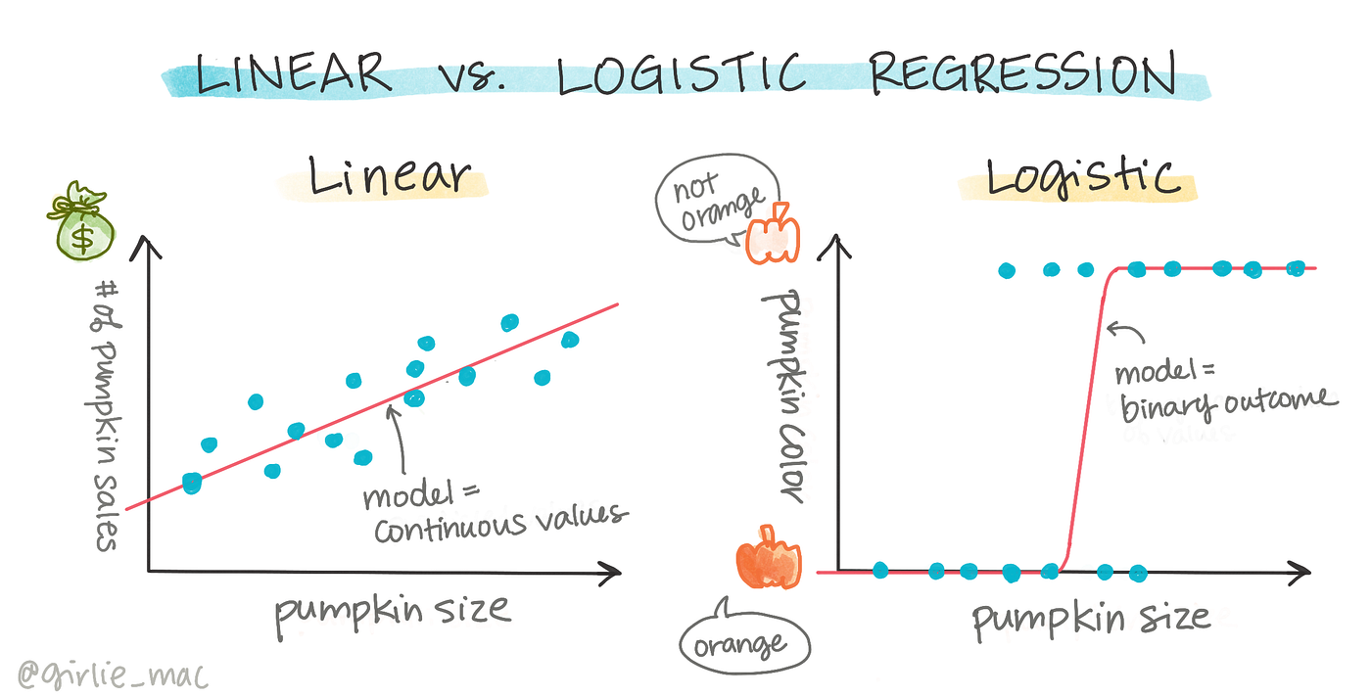

Slide 18

Numerical 1
Given:
$$w_{0}=−1, w_{1}=0.5$$
Input:
$$x=2$$
Predict the value of y

Slide 19

Logistic regression
🔷 Step 1: Compute $z$
$$z=w_{0}+w_{1}x$$
$$z=−1+\left(0.5\right)\left(2\right)=−1+1=0$$
🔷 Step 2: Apply Sigmoid
$$σ\left(z\right)=\frac{1}{1+e^{−z}}$$
$$σ\left(0\right)=\frac{1}{1+1}=0.5$$

Slide 20

Logistic regression
🔷 Step 3: Final Prediction
$$p=0.5$$
Decision:
$p≥0.5⇒y=1$
✅ Final Answer:
Probability = 0.5
Predicted class = 1

Slide 21

Numerical 2
Given:
$$w_{0}=−2, w_{1}=1$$
Input:
$$x=3$$
Predict the value of y
✅ Final Answer:
Probability ≈ 0.73
Class = 1

Slide 22

Numerical 3: Multiple Features
Given:
$$w=\left[0.5 , −1\right], b=0$$
$$x=\left[2 , 1\right]$$

Slide 23

Logistic regression
🔷 Step 1: Compute $z$
$$z=\left(0.5\right)\left(2\right)+\left(−1\right)\left(1\right)+0$$
$$z=1−1=0$$
🔷 Step 2: Sigmoid
$$σ\left(0\right)=0.5$$
🔷 Step 3: Prediction
$$y=1$$
✅ Final Answer:
Probability = 0.5
Class = 1

Slide 24

Loss Function
Logistic regression predicts a probability:
$$p=\frac{1}{1+e^{−z}}$$
We need a way to measure: 👉 How wrong is this probability compared to actual label?

Slide 25

Logistic regression
Loss Function (for one data point)
$$L=−\left[ylog⁡\left(p\right)+\left(1−y\right)log⁡\left(1−p\right)\right]$$
This is called: 👉 Binary Cross-Entropy Loss

Slide 26
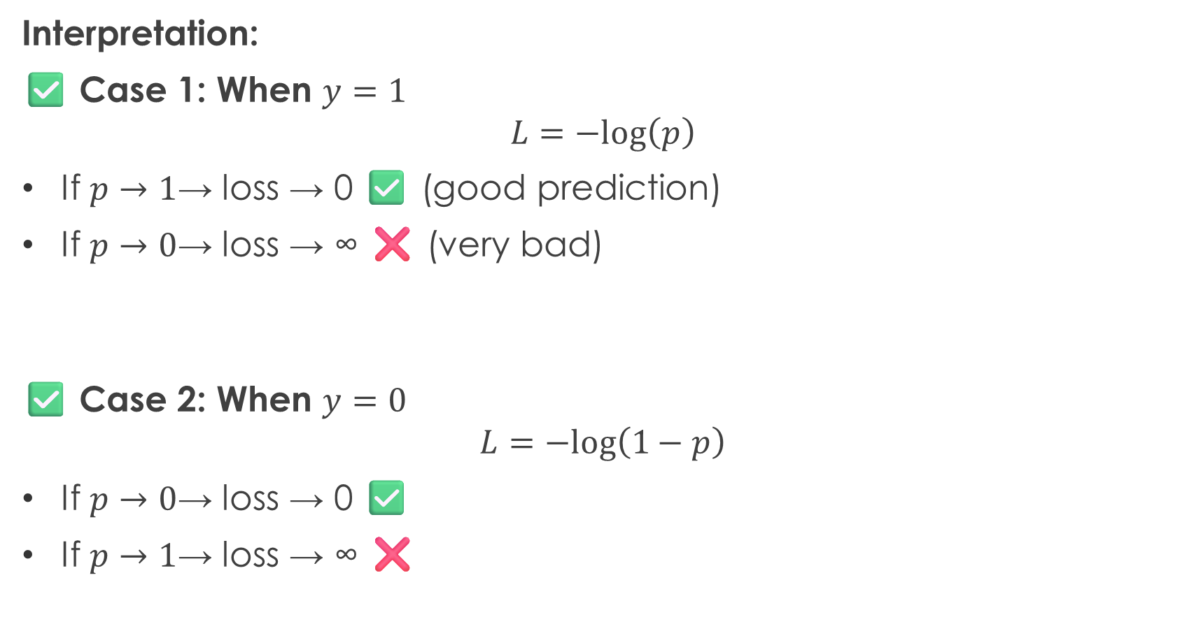
Logistic regression
Interpretation:
✅ Case 1: When $y=1$
$$L=−log⁡\left(p\right)$$
If $p→1$→ loss → 0 ✅ (good prediction)
If $p→0$→ loss → ∞ ❌ (very bad)
✅ Case 2: When $y=0$
$$L=−log⁡\left(1−p\right)$$
If $p→0$→ loss → 0 ✅
If $p→1$→ loss → ∞ ❌

Slide 27

Logistic regression
For whole dataset
$$L=−\sum_{i=1}^{n}{\left[y_{i}log⁡\left(p_{i}\right)+\left(1−y_{i}\right)log⁡\left(1−p_{i}\right)\right]}$$

Slide 28

Numerical 1
Given:
A logistic regression model predicts:
$$p=0.7$$
Actual label:
$$y=1$$
❓ Find the loss.

Slide 29

Logistic regression
✅ Solution:
Use formula:
$$L=−\left[ylog⁡\left(p\right)+\left(1−y\right)log⁡\left(1−p\right)\right]$$
Substitute:
$$L=−\left[1⋅log⁡\left(0.7\right)+0\right]$$
$$L=−log⁡\left(0.7\right)$$
$$log⁡\left(0.7\right)≈−0.357$$
$$L≈0.357$$
✅ Final Answer:
$$L≈0.357$$

Slide 30
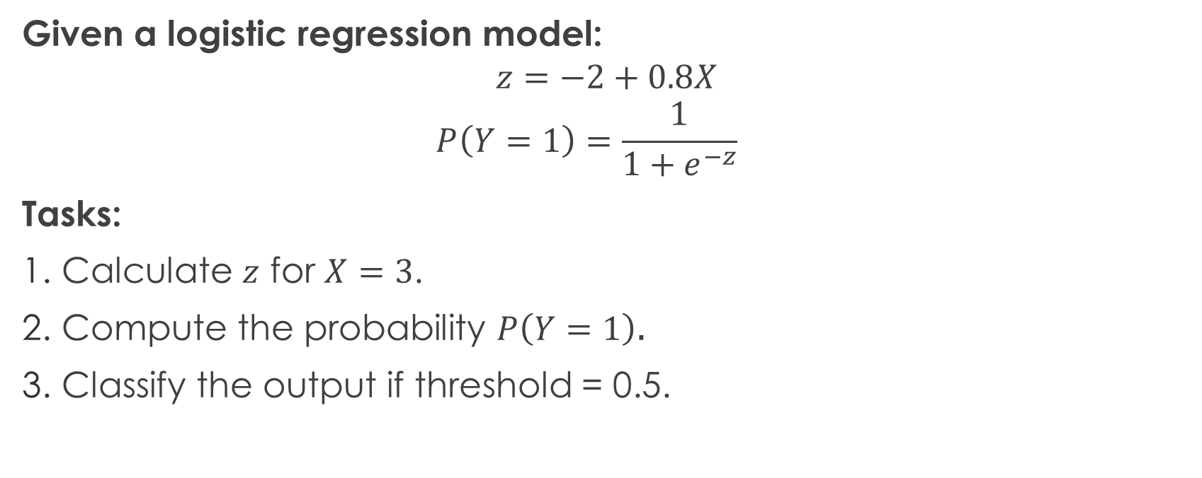
Numerical 2
Given a logistic regression model:
$$z=−2+0.8X$$
$$P\left(Y=1\right)=\frac{1}{1+e^{−z}}$$
Tasks:
Calculate $z$ for $X=3$.
Compute the probability $P\left(Y=1\right)$.
Classify the output if threshold = 0.5.

Slide 31
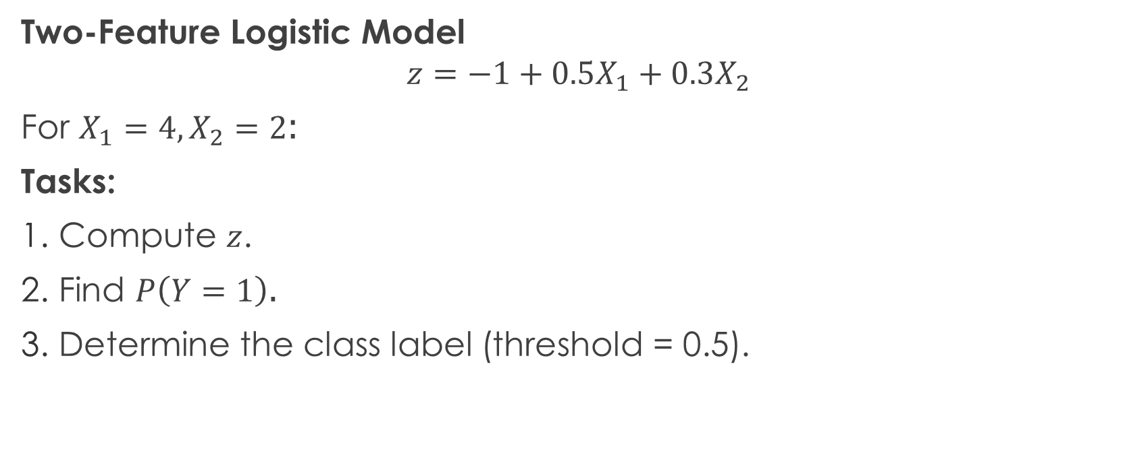
Numerical 3
Two-Feature Logistic Model
$$z=−1+0.5X_{1}+0.3X_{2}$$
For $X_{1}=4,X_{2}=2$:
Tasks:
Compute $z$.
Find $P\left(Y=1\right)$.
Determine the class label (threshold = 0.5).

Slide 32
Thank You

